Slide 1

OFFICE MANAGEMENT PORT
LINK : http://officemanagementportal.lenorasystemsinternal.com/

Slide 2
Credentials For OMP
Super Admin:
UserName - Bhaskar@lenorsystems.com
Password - Bhaskar
Admin:
UserName - sridhar@lenorasystems.com
Password - Sridhar
Super User:
UserName - nihar@lenorasystems.com
Password - nihar
User:
UserName - ubshankar452@lenorasystems.com
Password - shankar

Slide 3
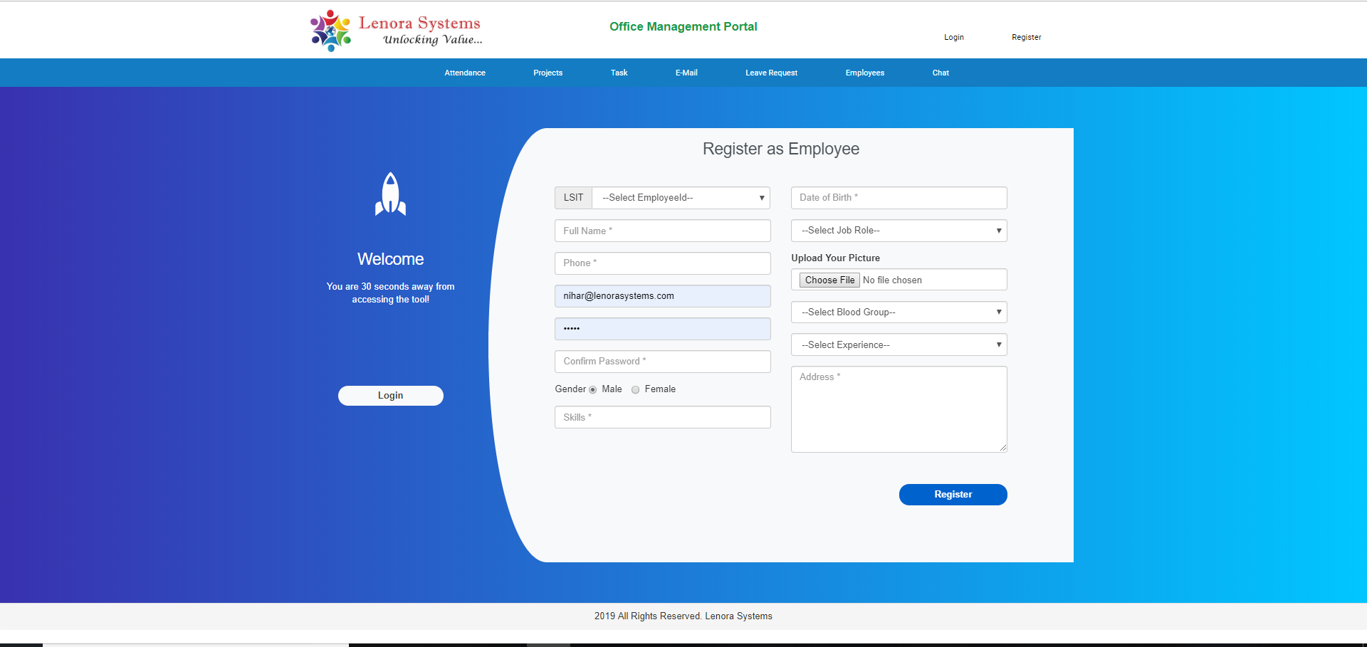
Registration Page
Here by using the registration page we can register users based upon the job role selection.

Slide 4
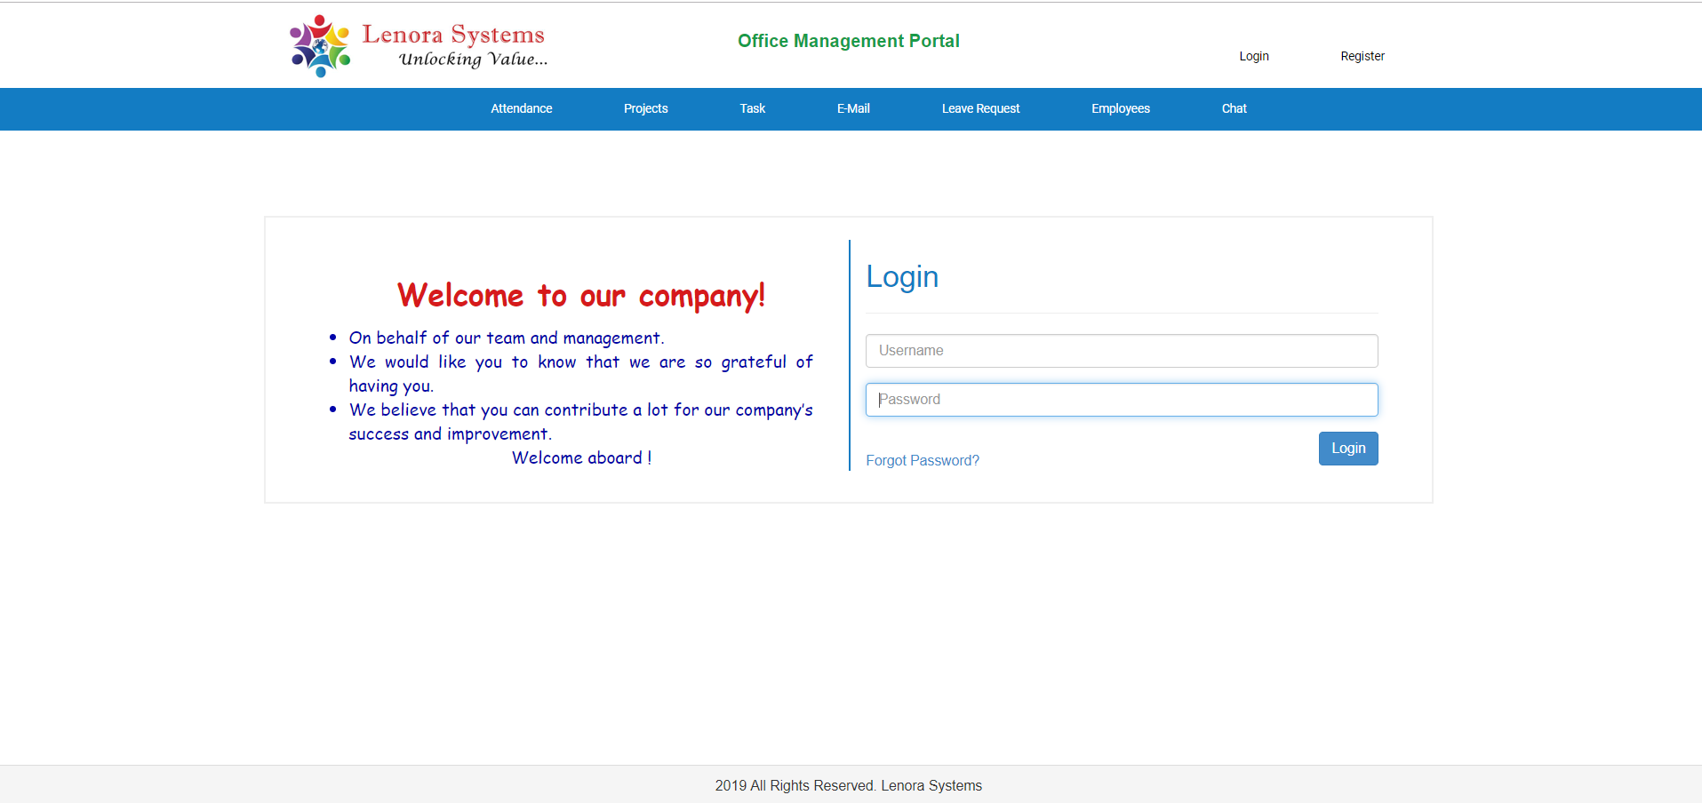
Login Page
1. Here in the Login Page we will validate the credentials based on registered username and password.

Slide 5
Super Admin

Slide 6
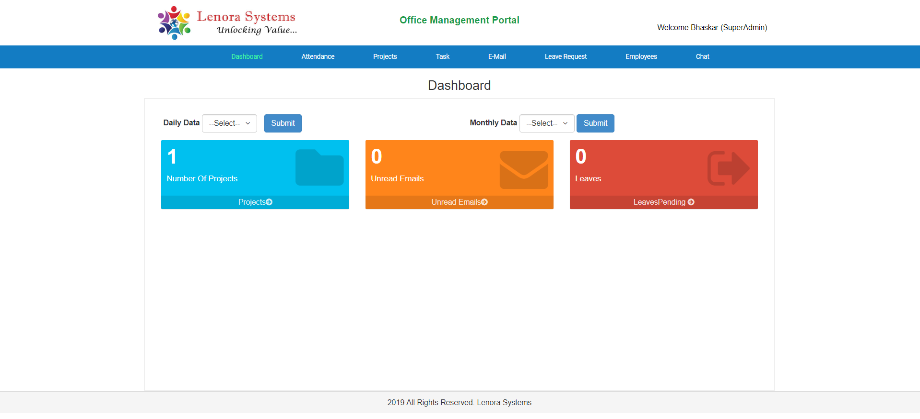
DashBoard
Based on selection of the Daily and monthly data drop downs we can get respective employee performance.
Number of Projects Grid will display the projects count.
Unread emails Grid will display the unread emails count.
Leaves Grid will display the Leave request count.

Slide 7
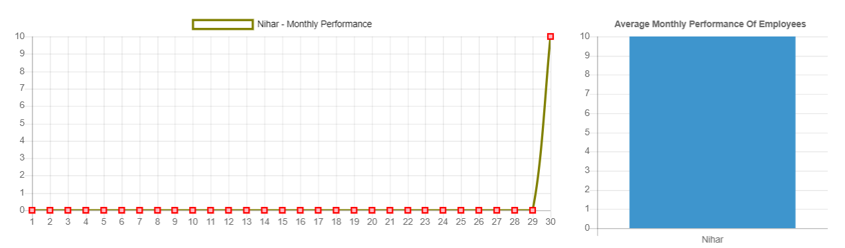
Daily and Monthly Data

Slide 8
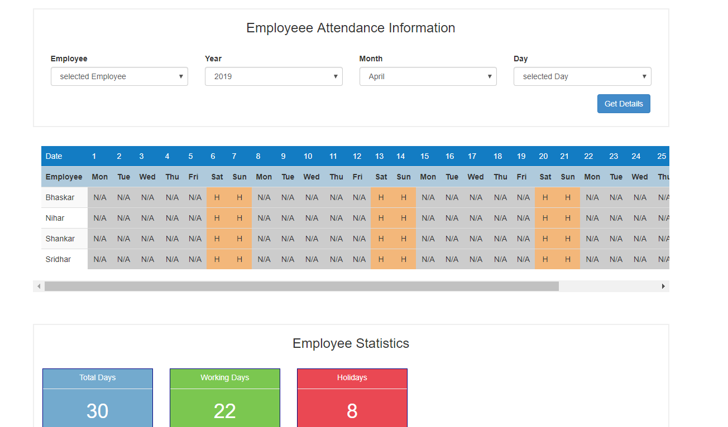
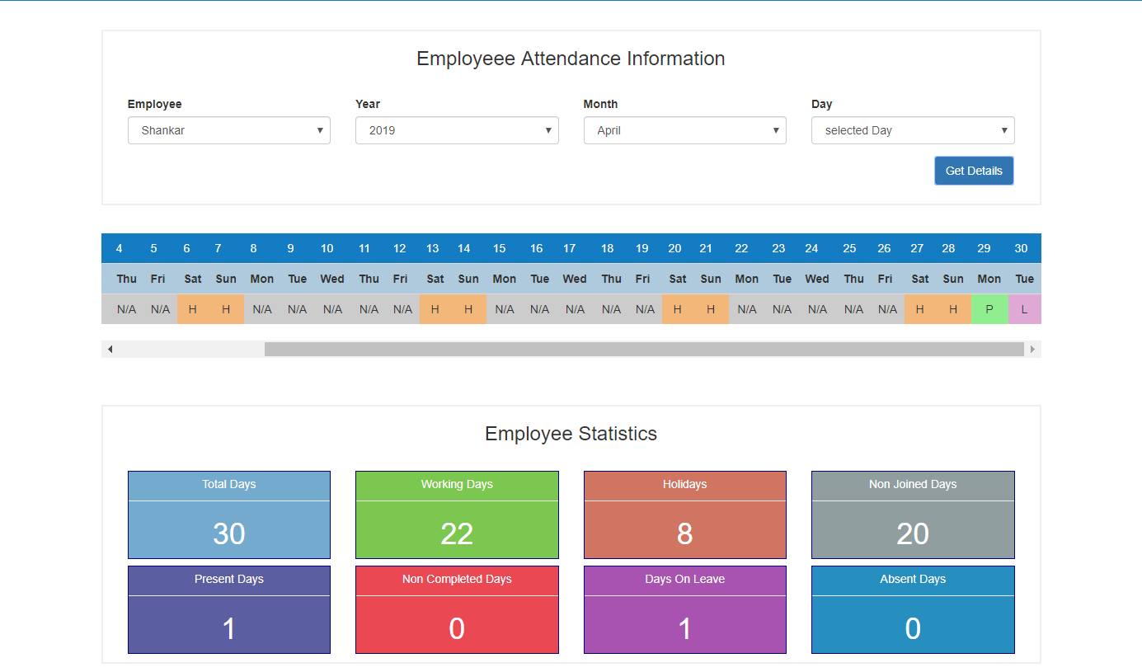
Attendance Page

Slide 9
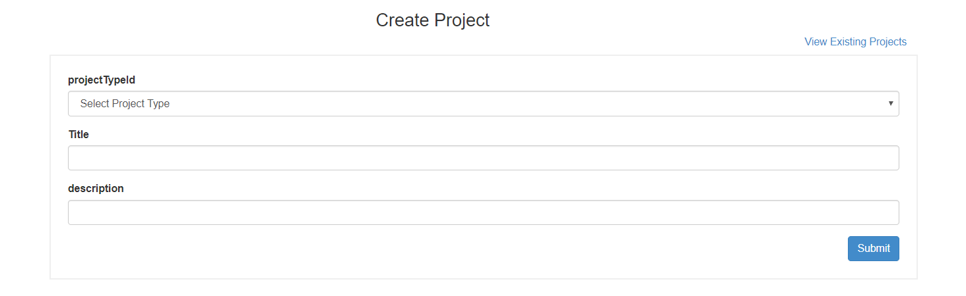
Create Project Page
We can create both internal and external projects based on selection of project type drop down.

Slide 10
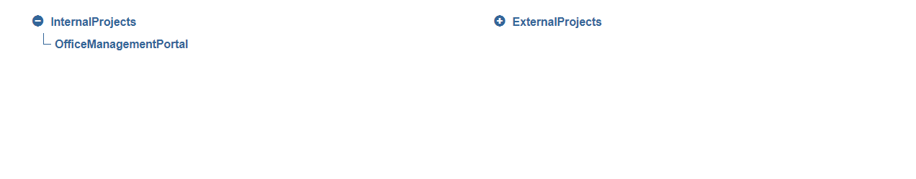
View Existing Projects
We can view all the existing internal and external projects.

Slide 11
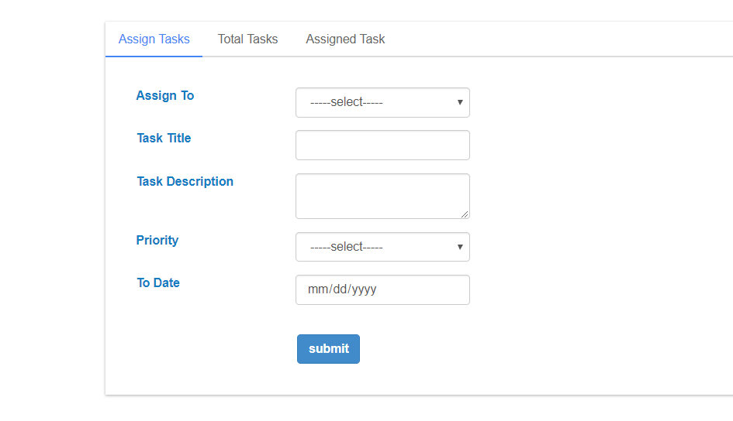
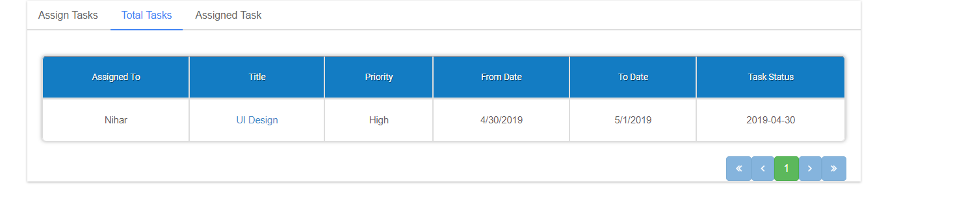
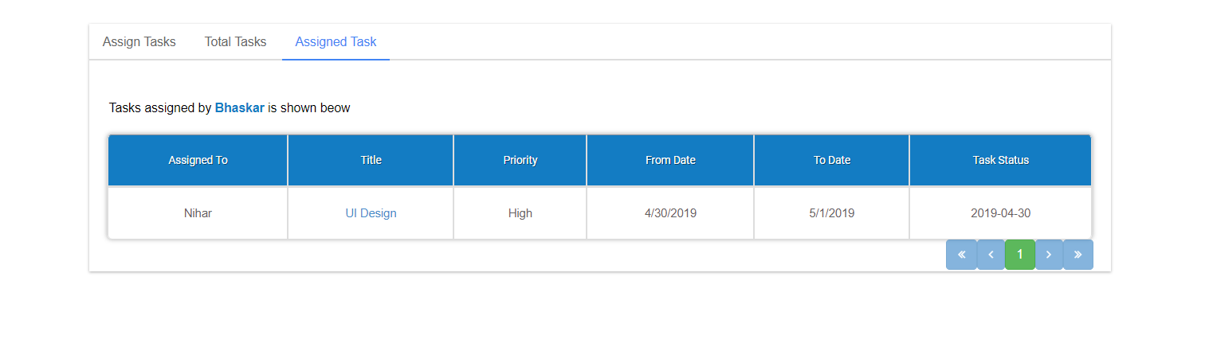
Task Page

Slide 12
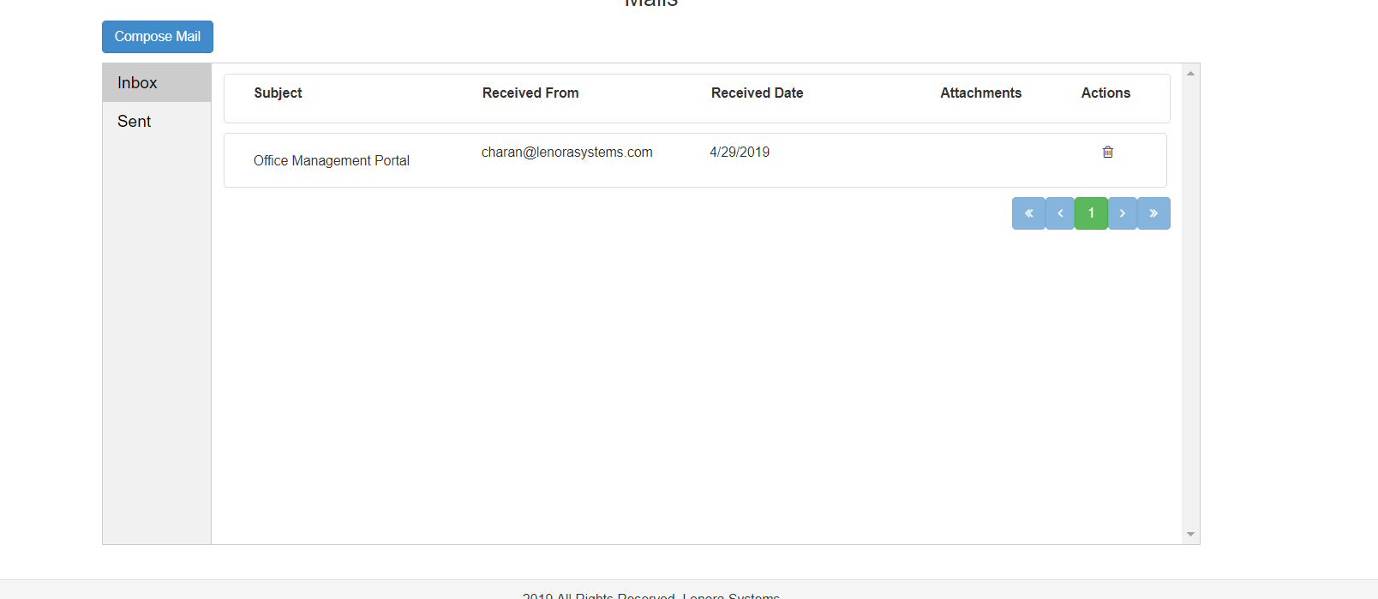
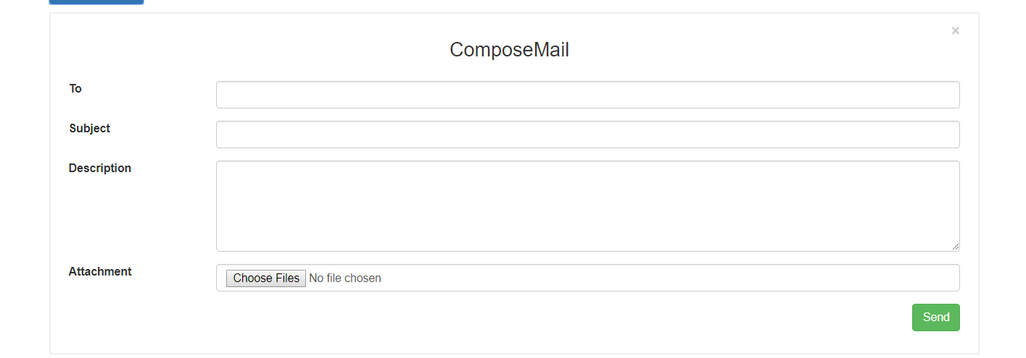
Mail Page

Slide 13
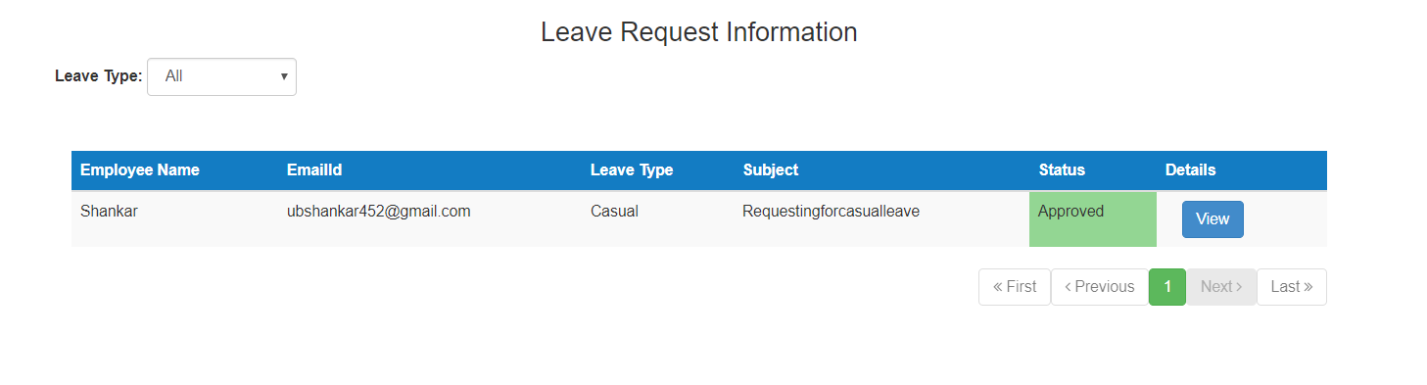
Leave Request Page
1. We can view all the approved, rejected and both based on change of leave type drop down.

Slide 14
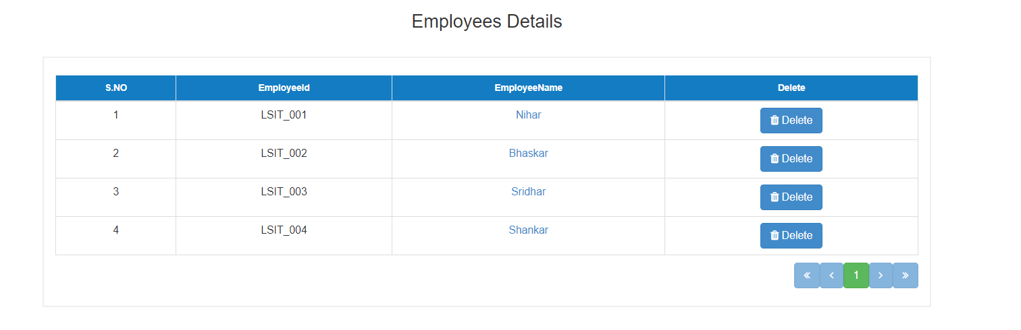
Employees Page
We can view all the employees details.
We can also delete the employee from this page.

Slide 15
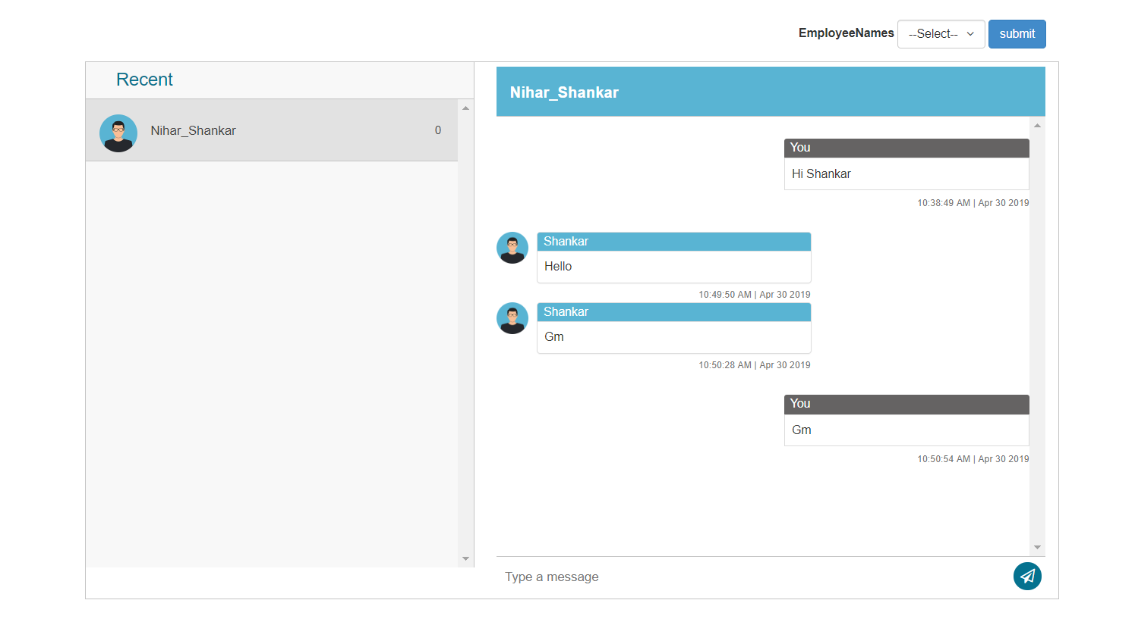
Chat Page

Slide 16
Admin

Slide 17
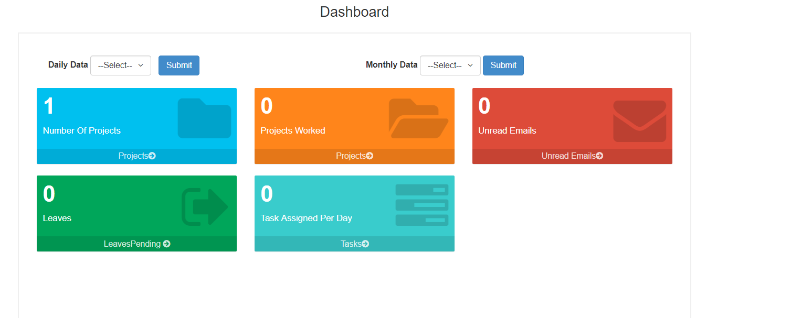
Dashboard

Slide 18
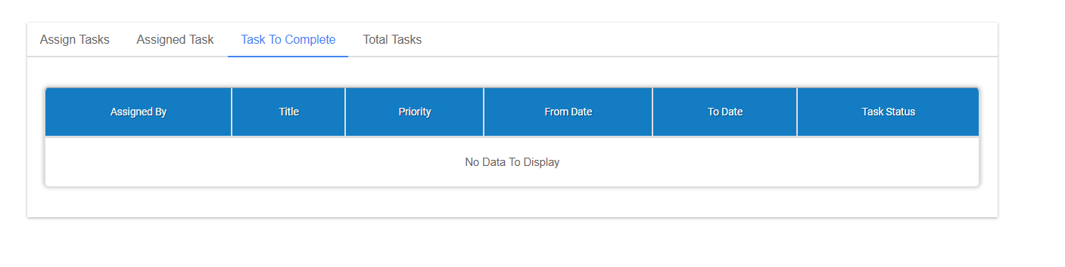
Task Page

Slide 19
Super User

Slide 20
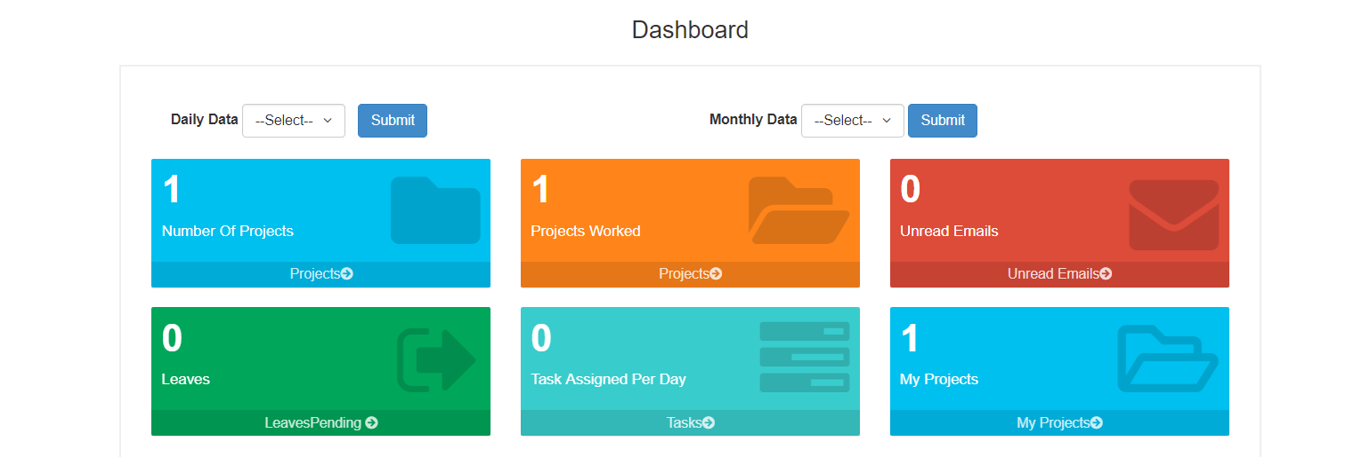
Dashboard

Slide 21
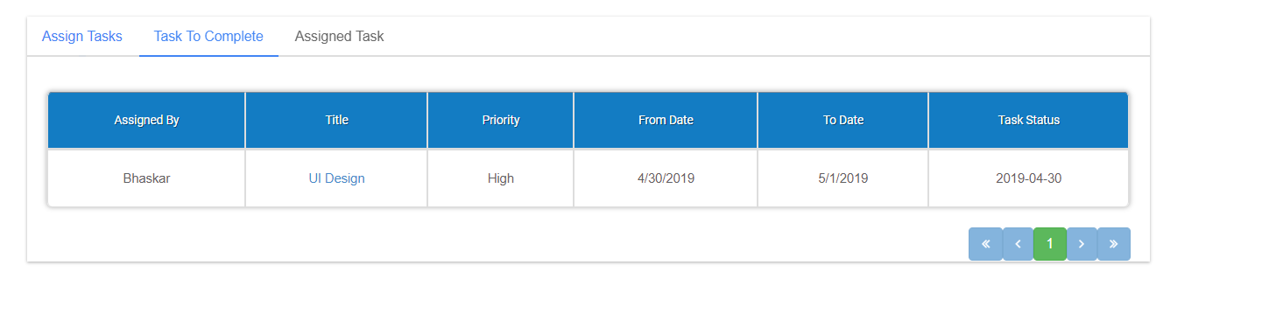
Task Page

Slide 22
User

Slide 23
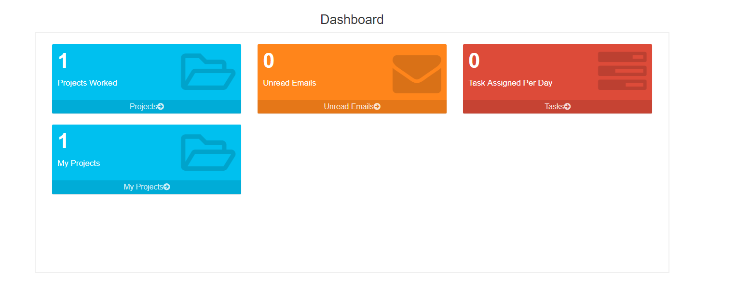
Dashboard

Slide 24
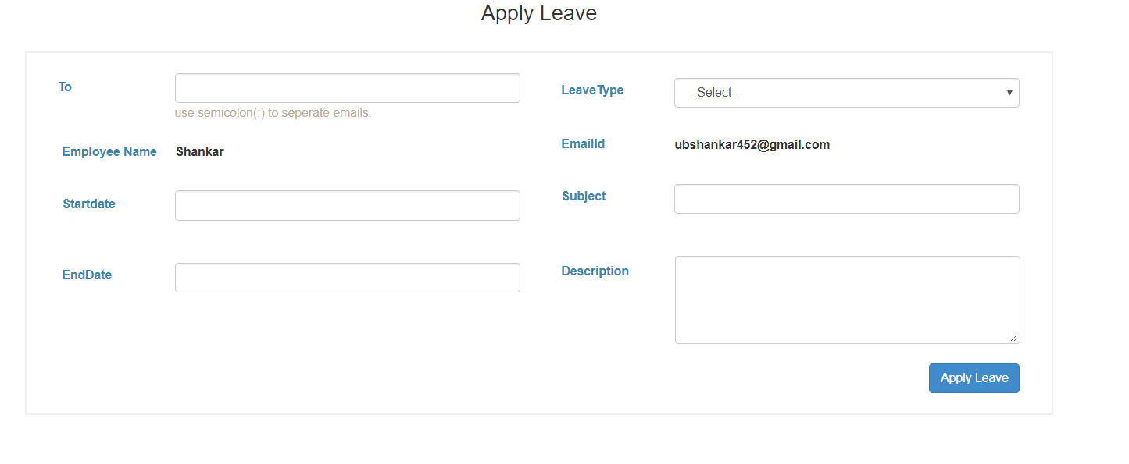
Leave Request

Slide 25
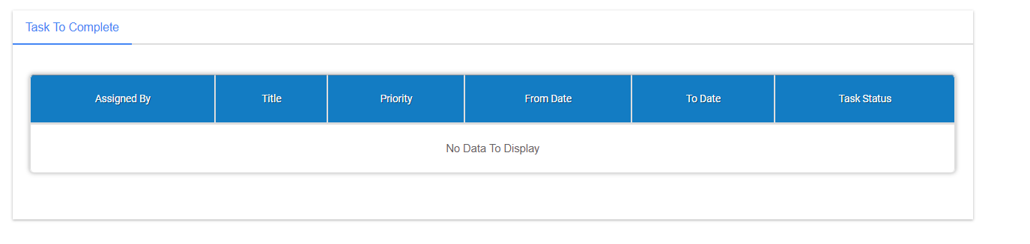
Task Page

